Slide 1
Road Accident Data Analysis
(2023 &2024)

Slide 2
Requirement:
Client wants to create a Road Accident Dashboard for year 2023 and 2024 so that they can have insights on the below requirements:-
Primary KPI: Total casualties taken place after the accident.
Primary KPI’s: Total casualties and percentage of total with respect to accident severity and maximum casualties by type of vehicle.
Secondary KPI’s: Total casualties with respect to vehicle type.
Monthly trend showing comparison of casualties for Current year and Previous year.
Maximum casualties by road type.
Distribution of total casualties by road surface.
Relation between casualties by Area/Location & Day/Night.

Slide 3
Stakeholders Involved:
Ministry of Transport
Road Transport Department
Police Force
Emergency Services Department
Road Safety Corps
Transport Operators
Traffic Management Agencies
Public
Media

Slide 4
Process Involved in the Road Accident
Data Problem
✅ Started with unstructured data: Gathered raw accident records and recognized the need for a clean, usable dataset before doing any analysis on them.
🧹 Cleaned and organized the data for analysis: Removed duplicates, handled missing values, and standardized different categories to create a structured base.
📊 Identified key metrics (KPIs): Focused on accident frequency, severity, and timing to identify high-risk areas and periods.
📈 Explored patterns through time-series analysis: Tracked monthly fluctuations to spot seasonal or recurring spikes in accident cases.
🛣️ Segmented the data by key influencing factors: Broke down accidents based on road conditions, surface types, location types (urban vs rural), and time of day (light vs dark).
🧠 Transformed data into actionable visuals: Used charts and dashboard tools to simplify the data story and highlight critical patterns visually.
📋 Documented every step for transparency and reproducibility: Maintained a dedicated analyst sheet to ensure the process was traceable and easy to communicate.

Slide 5
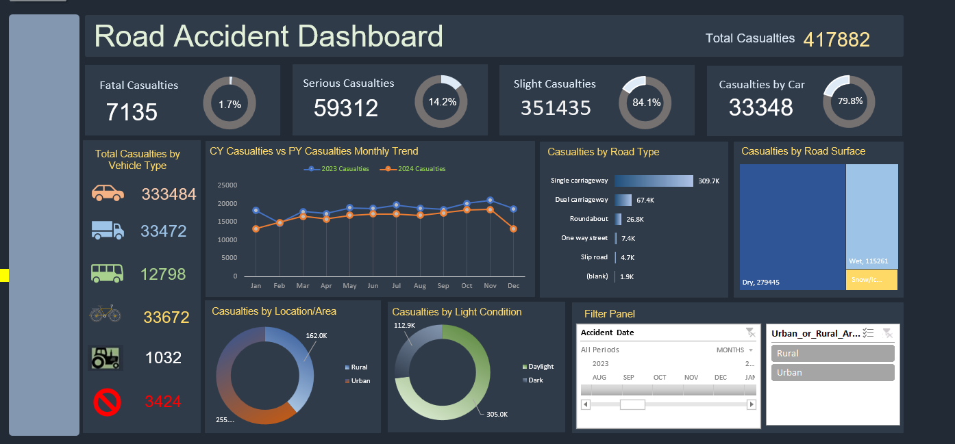
Final Dashboard

Slide 6
Key Insights
Accidents weren’t random — They spiked during certain months, hinting at seasonal or environmental triggers.
Urban areas saw more crashes, but rural areas had deadlier ones, possibly due to delayed medical aid or infrastructure gaps.
Slippery or damaged road surfaces were common factors in a large number of accidents.
Night-time accidents were more severe, showing the importance of proper lighting and visibility measures.
Straight roads had more incidents, but curves were deadlier, suggesting drivers underestimate straight paths and overcompensate on bends.
Created actionable KPIs to help identify where, when, and why interventions are most needed.

Slide 7
Conclusion
This project helped turn raw accident data into a structured, insightful narrative. While the patterns revealed clear problem areas—like time, location, and road conditions—the real value lies in how such data can support targeted safety interventions.
Meta Data:
File Extension: .xlsx
No of Rows: 3.07 lakhs
No of Fields: 21

Slide 8
THANK YOU

